Slide 1











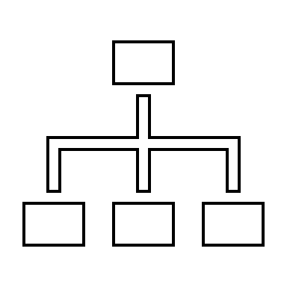








Looking Out the Window:
Helicopter Pilots’ Landing-Focused Information Gathering
Nejc Sedlar, Dr Amy Irwin, & Prof Amelia Hunt
School of Psychology, University of Aberdeen, Scotland
  Lapses in situation awareness (perception and comprehension of elements within the environment and the anticipation of future states) have been identified as major contributors to helicopter accidents, most often resulting in LOC-I or CFIT.
  Due to limited attentional resources, and the complexity of operational environments (especially during landings), the efficiency of information gathering is of particular importance.
  While extensive research has been conducted within fixed-wing operations, operational differences (mission types, flight/landing profiles, types of landing sites etc.) suggest helicopter-specific studies on information gathering are necessary.
Landing-Based Information Gathering During Stages of Flight
Introduction
Pre-departure
Gather landing site information
  Check landing site documentation
    Landing site location/characteristics
    Information on obstacles/hazards
    Site classification/restrictions
  Use satellite imagery
  Communicate with destination
Check weather
  General weather report for route
  Site-specific weather
Integrate aircraft specifications
  Landing fuel and load requirements/capabilities
    “And the loads as well… because there's limits on centre of gravity or how much fuel we can take or how much fuel we need” (P18 OT)
Crew brief
  Discussion of key site characteristics
H
*LOC-I – Loss of Control Inflight; CFIT – Controlled Flight Into Terrain
    What information do pilots require to conduct landings and where do they get that information?
Key questions
    What are the factors that affect the type of information required and the sources from where it is obtained?
    What strategies do pilots use to effectively and efficiently gather information necessary for landing?
Participants
Interviews
Analysis
Cruise
Update/gather information about the destination
  Communicate with destination
  Landing site documentation
  Brief landing site information
  Monitor OTW information
Crew approach briefing
  Discussion of the planned approach
    “it'll be briefed, and we will talk through what approaches are available, how we're going to do that in the cockpit, provided there's, you know, sufficient time.” (P1 SAR)
Semi-structured interviews
Landing task steps
Interaction with the cockpit
Flying role
Hierarchical Task Analysis
Methods
SAR (7)
OT (8)
Military (3)
HEMS (3)
Content Analysis
*SAR – Search and Rescue; OT – Offshore Transport; HEMS – Helicopter Emergency Medical Service (Air Ambulance)
Factors Affecting Information Gathering
Approach
Establish, update, or confirm information
  Identify landing site
    “It is identifying the airfield, identifying the runway, identifying any other traffic, identifying any obstructions, which, generally, there shouldn't be.” (P15 SAR)
  Evaluate the condition of the landing site and surroundings (e.g., RECCE)
  Establish/confirm wind and weather information
Landing briefing and checks
  Crew briefing on the planned landing
    “give the briefing of how are we going to approach the landing site? How are we going to land? …you go through the checklist together, so a challenge and response thing.” (P12 OT)
  Confirm landing site identity and landing permission
Fly the approach
  Monitor risks
    Visual of site and surroundings
  Monitor flying parameters
    Predominantly visual – integrate with instrument information
  Communicate with crew
    PF – annunciate planned actions and thought processes
    PM – provide callouts and highlight deviations/risks
    Rear crew – Communicate hazards and provide feedback on aircraft movement
Task & Environmental
Operation/aircraft type
Landing site complexity
Environmental conditions
Flying role and crew composition
Individual & Team
Prior knowledge
Physiological state
Crew interaction
Instrument interaction
Task & Environmental
Information Gathering Optimising Strategies
Creation and Maintenance of a Mental Model
“You're probably going to be listening into radios to see what is going on, and try and build a picture in your head” (P1 SAR)
Teamwork/Communication
“the most active part of the crew is to acknowledge all the obstacles that the pilot flying didn’t report. And then we have a complete picture.” (P19 HEMS)
Integration of Visual Information
Landing
Establish a hover
  Use of external visual references
    “You’ll get yourself established in the hover by looking at those peripheral references… (P20 SAR)
  Rear crew check the site condition
Landing decision
  Committal point for landing
    “I will make a committed call, which is, the crew know that if, in the event of a power loss, or anything else happens now, I'm going into that field. I'm committed to that field.” (P10 Military)
H
“the cadence of the information that's coming to you and a periodic glance at the instruments is enough to reassure you that you're at a reasonable rate of closure.” (P16 OT)
n.sedlar.20@abdn.ac.uk
@NejcSedlar

